Slide 1
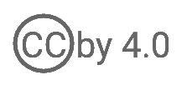
WSO2 API Manager 4.2.0 Developer Advanced
Deploy API Manager on Docker
WSO2 Training

Slide 2
Containers vs VMs

Slide 3
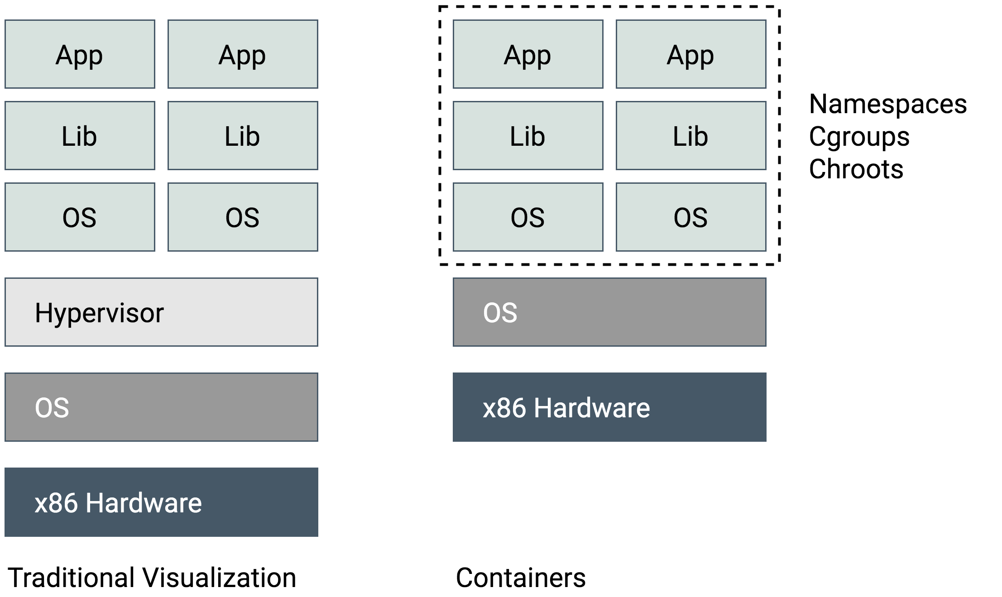
VMs vs Containers
Notes:
VMs
An emulation of a real computer
VMs run on top of a physical machine using a “hypervisor”.
A hypervisor, in turn, runs on either a host machine or on “bare-metal”.
A piece of software, firmware, or hardware
Allows for host computers to share their resources amongst the virtual machines that are running as guests on top of them.
Containers
Runs on the host machine’s OS
Lightweight

Slide 4
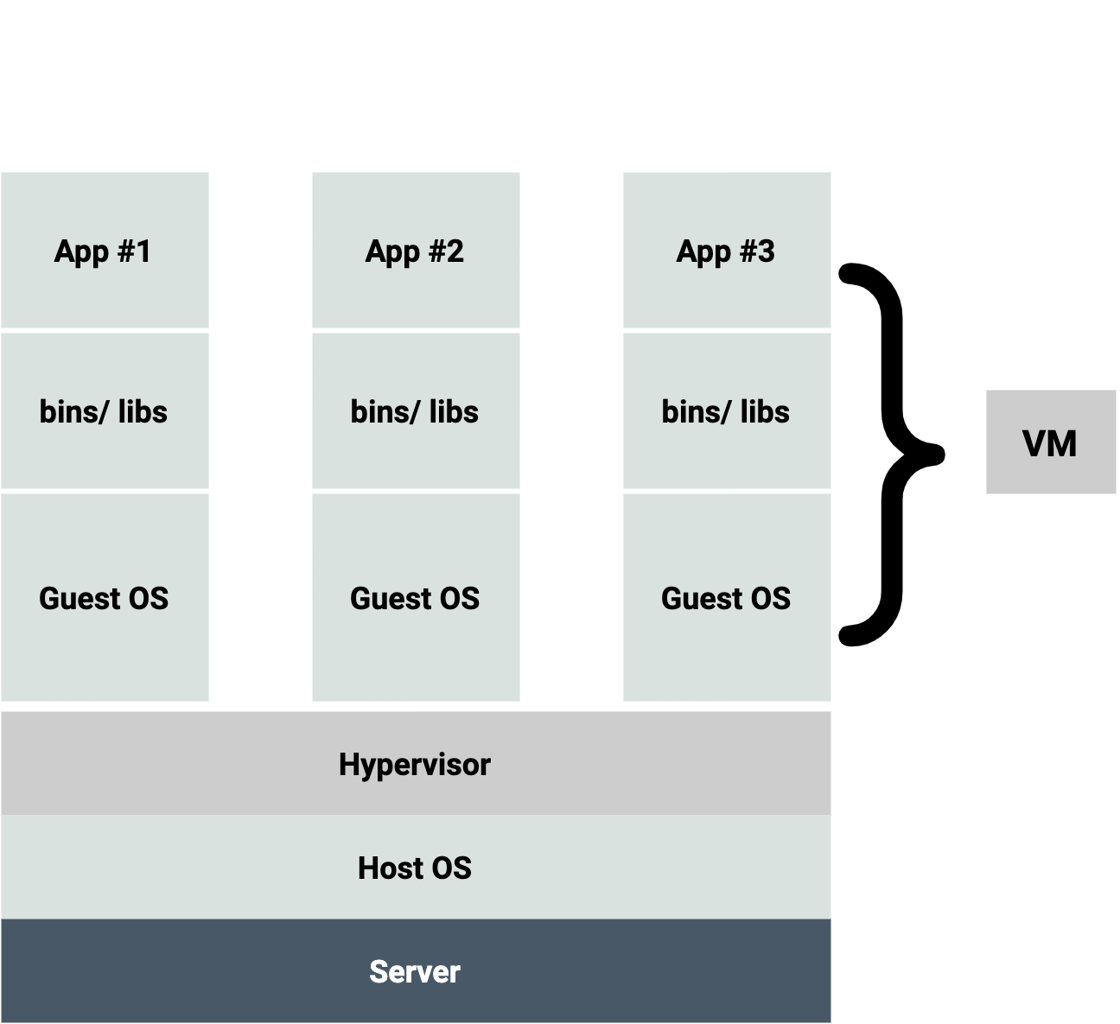
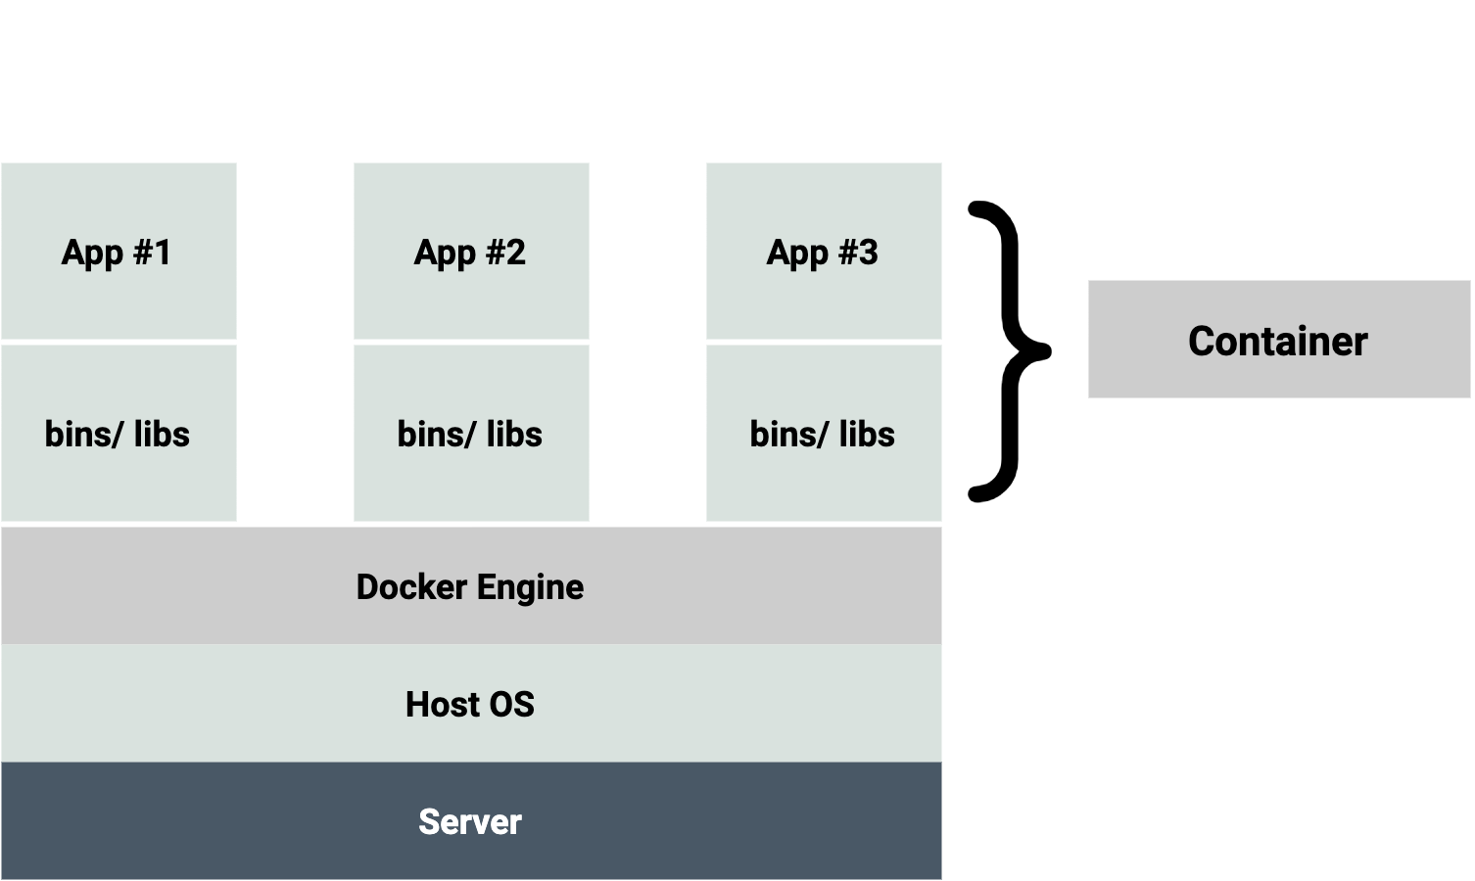
Why are Containers Special?
VM
Hardware virtualization
Container
Operating-system-level virtualization
Containers share the host system’s Kernel with other containers
Notes:
VMs run on top of a physical machine using a “hypervisor”. A hypervisor, in turn, runs on either a host machine or on “bare-metal”.
A hypervisor is a piece of software, firmware, or hardware that VMs run on top of, providing the VMs with a platform to manage and execute this guest operating system
Containers package up just the user space, and not the kernel or virtual hardware like a VM does.
Each container gets its own isolated user space to allow multiple containers to run on a single host machine
The only parts that are created from scratch are the bins and libs. This is what makes containers so lightweight.

Slide 5
Docker - Introduction

Slide 6
What is Docker?
Docker is a tool based on LXC (Linux Containers)
Easy to use
Fast
Docker Hub
Modularity and Scalability
An open platform for developers and sysadmins build, ship and run distributed applications
Notes:
It uses Linux Kernel features like namespaces and control groups to create containers on top of an operating system.
Other Linux container technologies include Solaris Zones, BSD jails, and LXC, which have been around for many years.
Easy to use: It allows anyone to package an application on their laptop, which in turn can run unmodified on any env
Speed: Docker containers are very lightweight and fast. You can create and run a Docker container in seconds, compared to VMs which might take longer because they have to boot up a full virtual operating system every time.

Slide 7
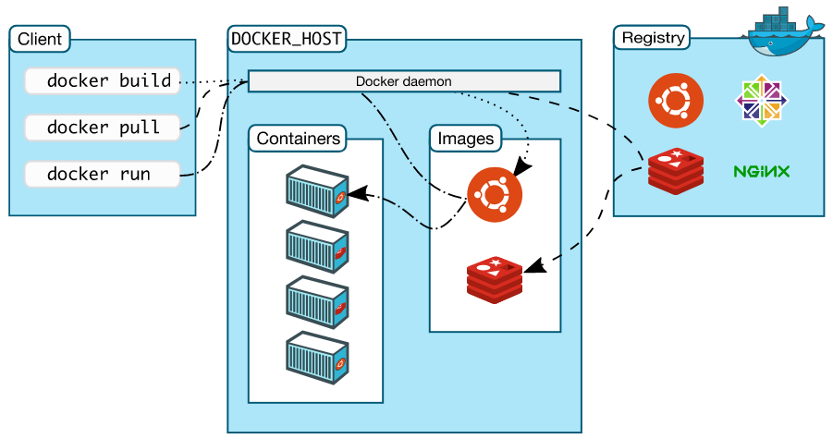
Docker Concepts
Docker client - Command Line Interface (CLI) for interfacing with the Docker
Dockerfile - Text file of Docker instructions used to assemble a Docker Image
Image - Hierarchies of files built from a Dockerfile, the file used as input to the docker build command
Container - Running instance of an Image using the docker run command
Registry—Image repository

Slide 8
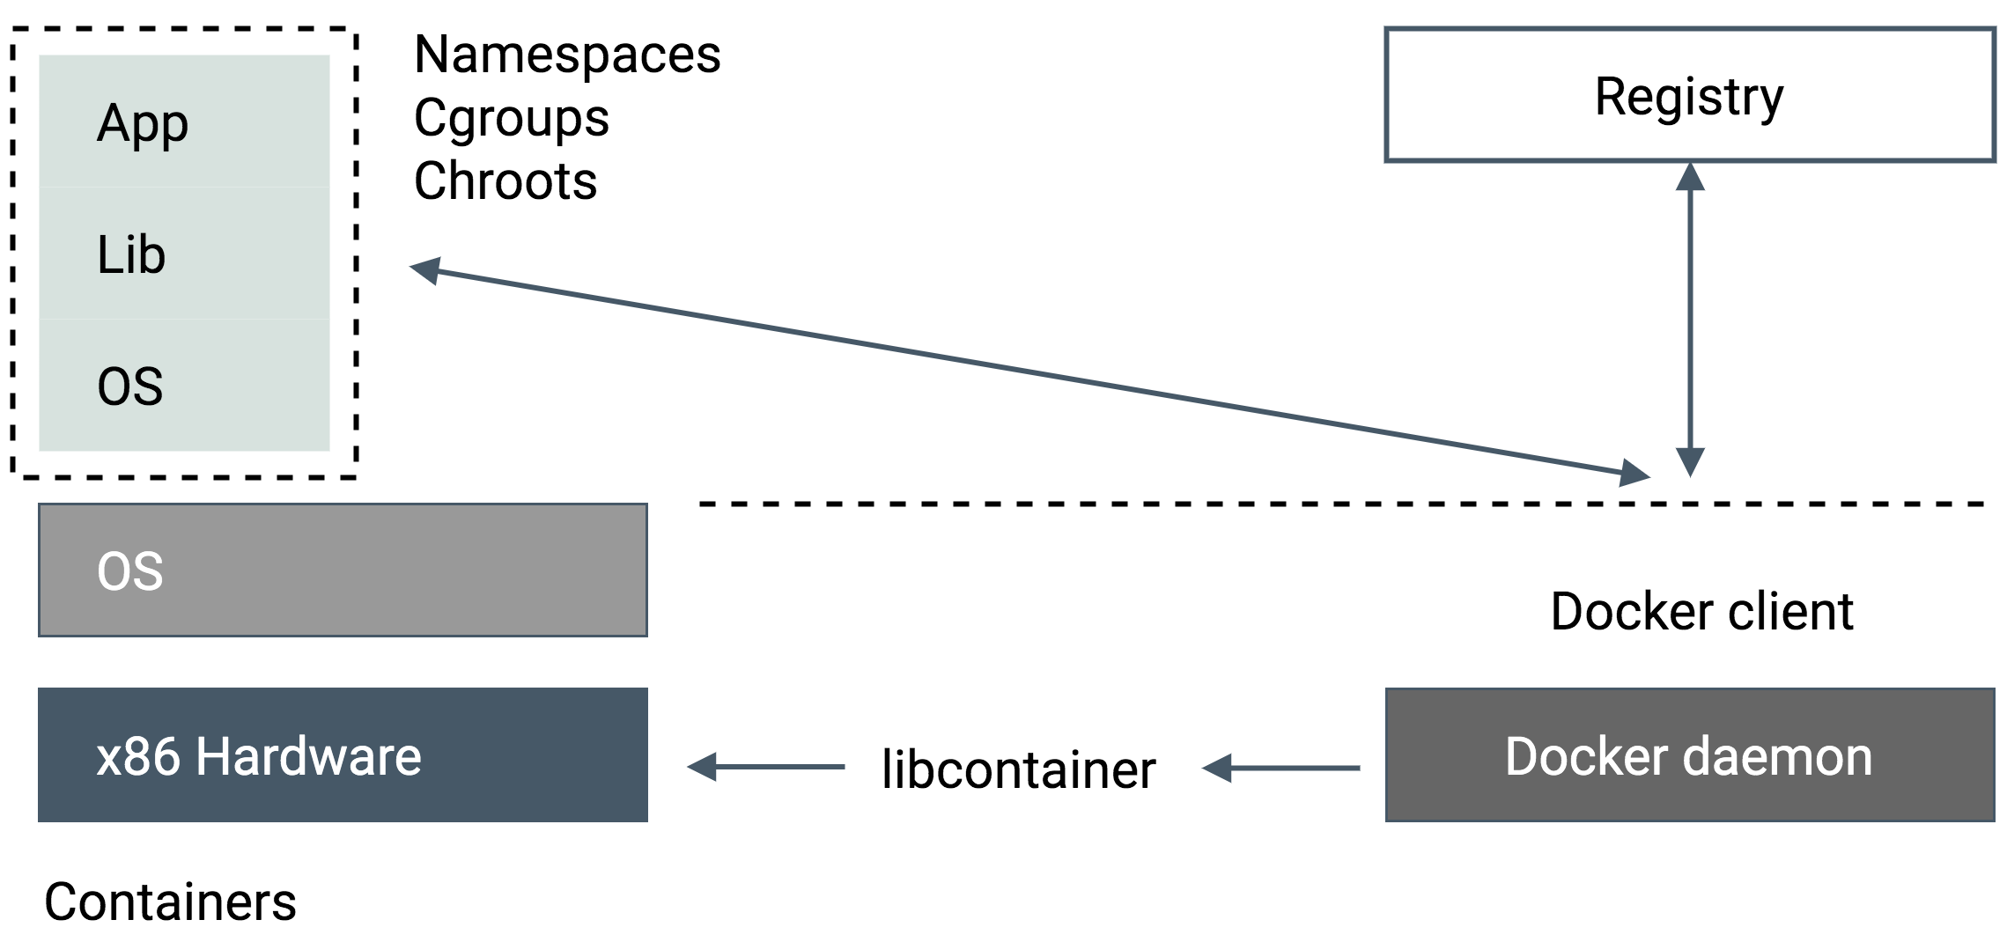
Docker Workflow

Slide 9
Docker Images

Slide 10
Docker Image
An image is a collection of files and some metadata
Images are comprised of multiple layers. Multiple layers referencing/based on another image (Union File System)
Each image contains software you want to run
Every image contains a base layer
Layers are read-only

Slide 11
Build Docker Image
Dockerfile content
# starting from ubuntu
FROM ubuntu:16.04
# update stuff
RUN apt-get update
# install python
RUN apt-get install -y --no-install-recommends \
--no-install-suggests python2.7
# mark the container
RUN mkdir -p /inside/container
# we have something running on 8000
EXPOSE 8000
# where should I sit
WORKDIR /app
# start this process for the
# container pls
ENTRYPOINT ["python2.7", "-m", "SimpleHTTPServer", "8000"]

Slide 12
Build and Run Docker Image
Build Docker Image
docker build -t sampleimage.
Run Docker Container from Image
docker run --rm -it --name my-docker-instance -p 80:8000 mysample
Show running docker processes
docker ps
Check logs of running container
docker logs <docker-process-id>
SSH into running docker container
docker exec -it <docker-process-id> /bin/bash

Slide 13
Run API Manager in Docker

Slide 14
Run API Manager In Docker
docker run -it -p 8280:8280 -p 8243:8243 -p 9443:9443 --name api-manager wso2/wso2am:4.2.0
Exposes default API-M ports from the docker container.
8280: The Gateway HTTP Port
8243: The Gateway HTTPS port
9443: The Management HTTPS port
Container Name: api-manager
Image: wso2/wso2am:4.2.0

Slide 15
Docker Volumes
Containers are immutable
“Data” part of a container
Initialized when a container is created
Exist as normal directories and files on the host file system
Destroying, updating, or rebuilding container won’t affect data volumes
Can be shared and reused among multiple containers

Slide 16
Production Grade Deployment
Use base image or fresh distribution to build target docker images with required configurations
Uses persistent volumes
Docker Compose as a tool
Cloud Service Providers offer platforms such as AWS ECS to deploy containers

Slide 17
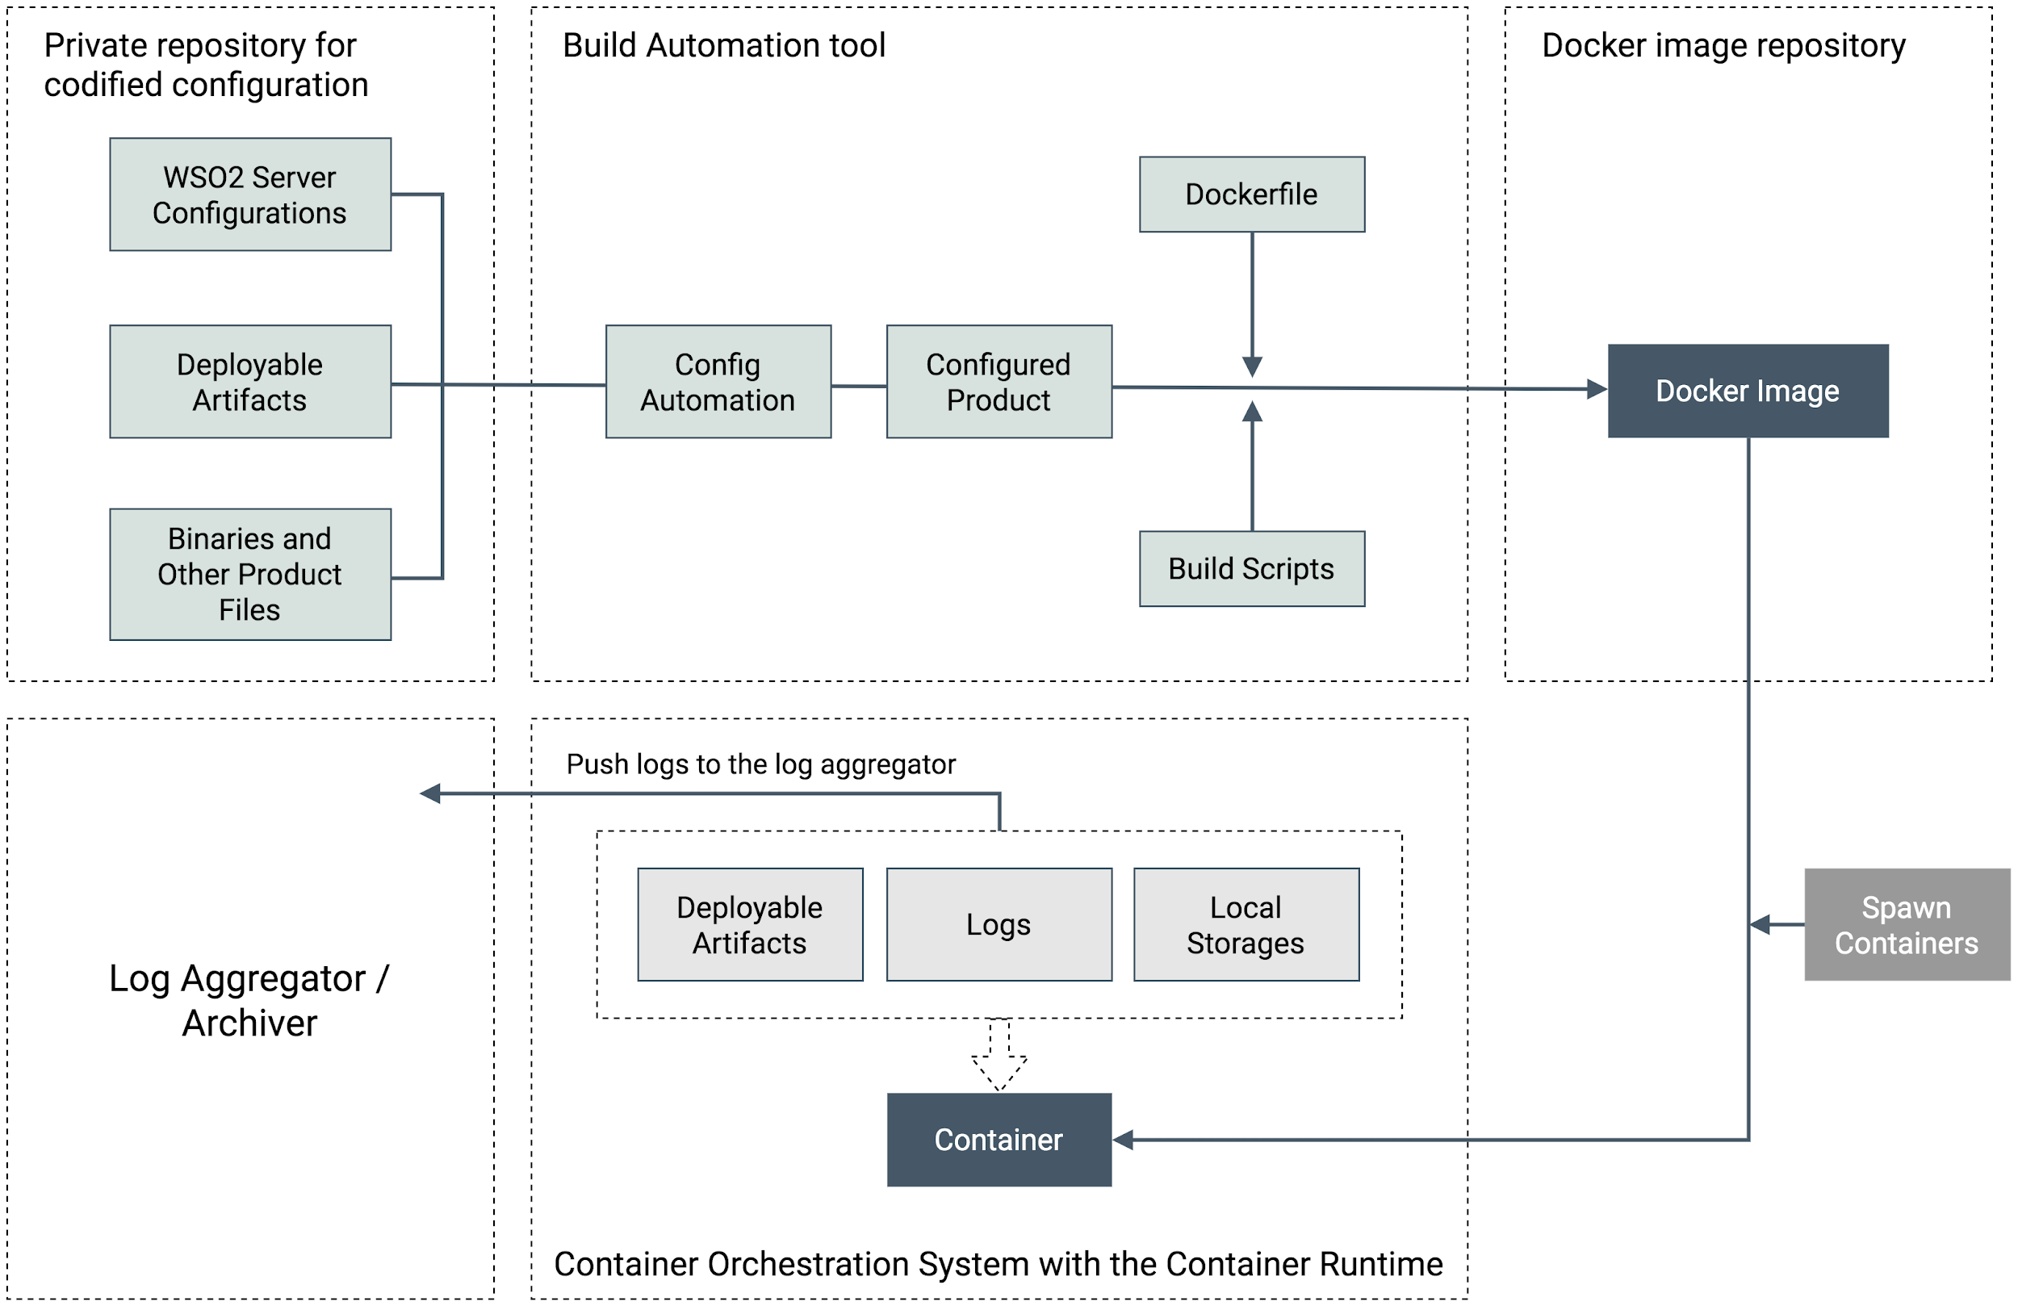
Configuring API Manager Distribution to Production Grade Image

Slide 18

Follow https://docs.docker.com/get-started/
Try out https://github.com/wso2/docker-apim/
Let’s try it out!

